Slide 1
IMS Presentation
By Elliott Dorrington

Slide 2
Introduction to me
BSc in Biology with Studies in the USA from the University of Salford graduating in July 2019.
Moved into coding when QA opportunity arose.
Now in week 5 at the training academy as a trainee software development consultant.

Slide 3
Specification
Using the knowledge gained from the 5 weeks spent in the academy training course, I was tasked with the creation of an Inventory Management System (IMS).
IMS required implementation of knowledge from various topics, such as;
Agile & Project Management
Databases
Cloud Fundamentals
Programming Fundamentals
Continuous Integration
Automated Testing

Slide 4
Analysis and Design
During the design of the project, I used several tools such as a Kanban board, an ERD and a UML diagram that helped form the basis of my project.
The code was analysed using SonarQube.
Risk assessment was taken on the possible risks that could be encountered.

Slide 5
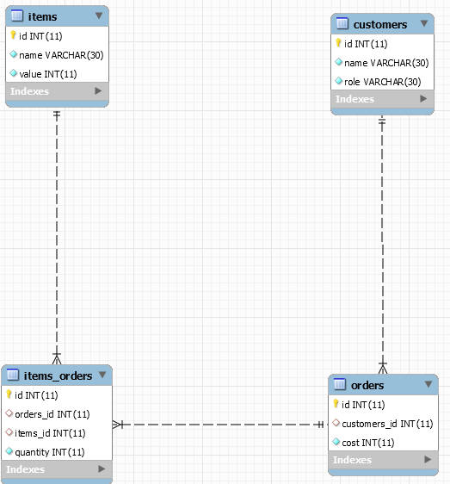
ERD (Entity Relationship Diagram)
The ERD allowed me to visualise a basic overview of the tables and attributes in my database.

Slide 6
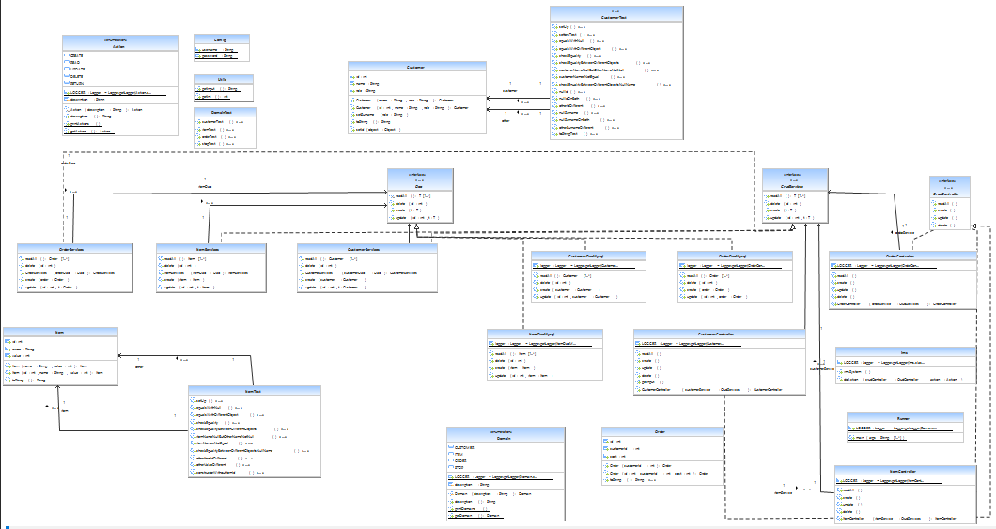
UML (Unified Modelling Language) Diagram
This UML Diagram allows the user to see how all my classes interact with each other.

Slide 7
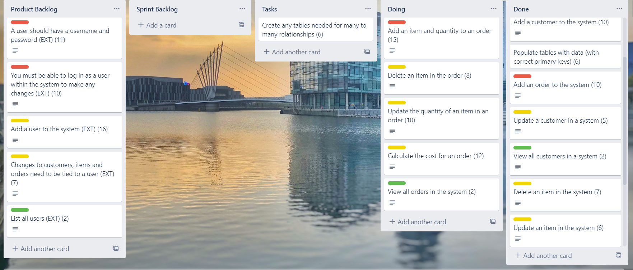
Trello Board
The Trello board was used to help me track project progress as I completed each element involved. It also showed me what my short-term goals were using the sprint backlog.

Slide 8
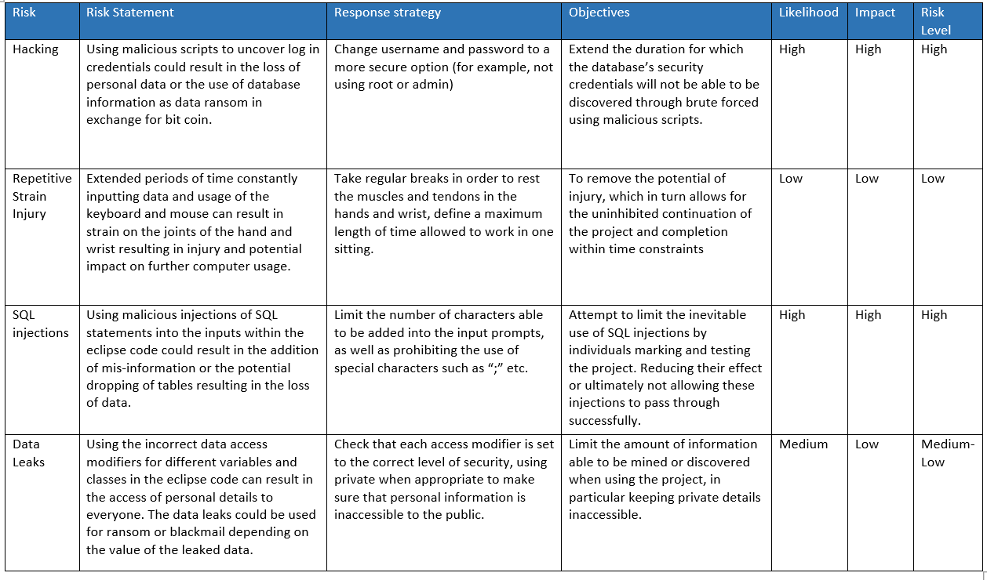
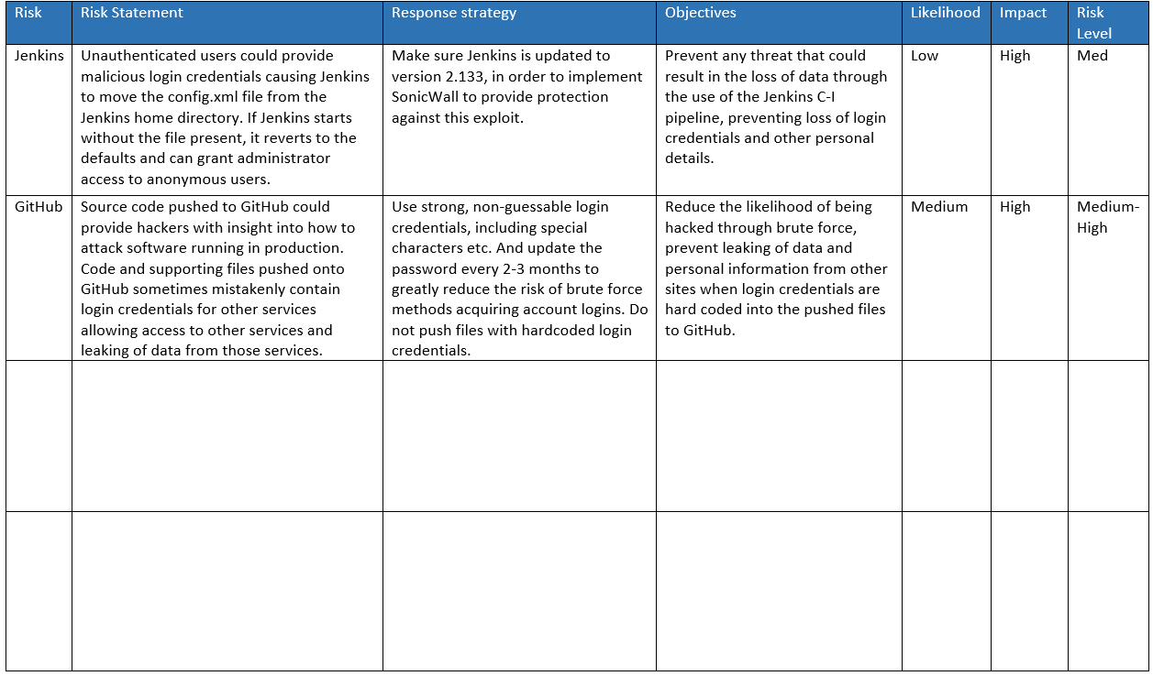
Risk Assessment
This Risk Assessment allowed me to keep track of any threats to project completion, as well as any risks that may arise during project work.

Slide 9
Coding
I used both SOLID and OOP principles in the design and creation of my project.
Single Responsibility - All of the DAO objects will only access the database once.
Open-Closed – Objects are closed to modification but can be implemented by other methods.
Liskov’s Substitution – Controller classes pass down subclasses of interfaces, working in the same way as passing down the interface itself.
Interface Segregation – All interfaces implemented by my classes are used
Dependency Inversion – All classes follow the dependency hierarchy, eg. Child classes depend on parent classes.

Slide 10
Testing
Code is run through SonarQube to check code quality and highlight any necessary changes to the code to help with security etc.
When building with maven all tests are run and the build will fail if any of the tests fail.
Mockito was used for Integration tests and Junit was used for unit tests.

Slide 11
Automation
I implemented automation into my project firstly through the use of the GCP (Google Cloud Platform) to create a virtual machine instance which hosts the Jenkins CI server.
Jenkins CI server is used to build the IMS whenever there are changes made to the main branch of the GitHub remote repository.
If the build succeeds then the code is passed to SonarQube to check the code quality and check for code smells.
When quality gates are passed, the code is added to the remote artefact repository Nexus.

Slide 12
How I would improve
More carefully plan my time
Implement a test-driven approach to the project
Focus on creating code, then fixing it rather than not creating code at all.

